Slide 1

DealTracker
https://github.com/buChloeCLY/CS501-Project-DealTracker
Team: Leyan Chen, Yijia Chen, Juling Fan

Slide 2
Problem Statement & Solution
Problem:
Online price comparison is fragmented and time-consuming
Prices vary across platforms for the same product
Users often miss short-term discounts
Generic recommendations ignore personal interests
User Need:
A fast and centralized way to compare prices
Timely alerts for price drops
Relevant, personalized product discovery
Solution:
Unified search across multiple e-commerce platforms
Real-time price comparison powered by APIs
Price tracking with notifications
Personalized recommendations based on user behavior

Slide 3
Live demo

Slide 4
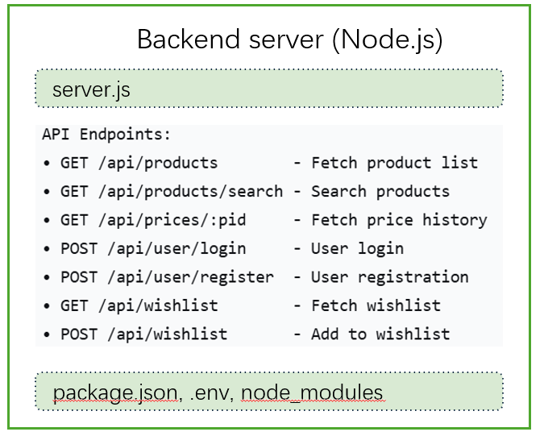
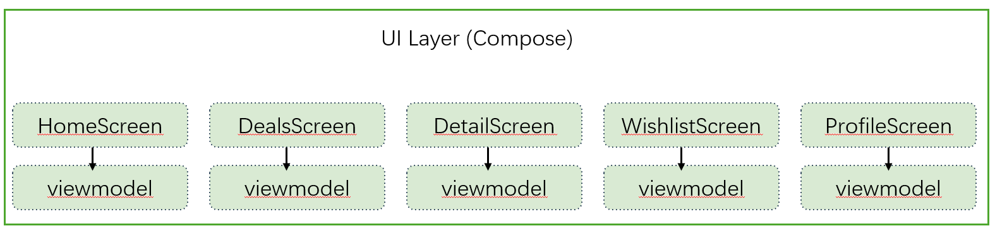
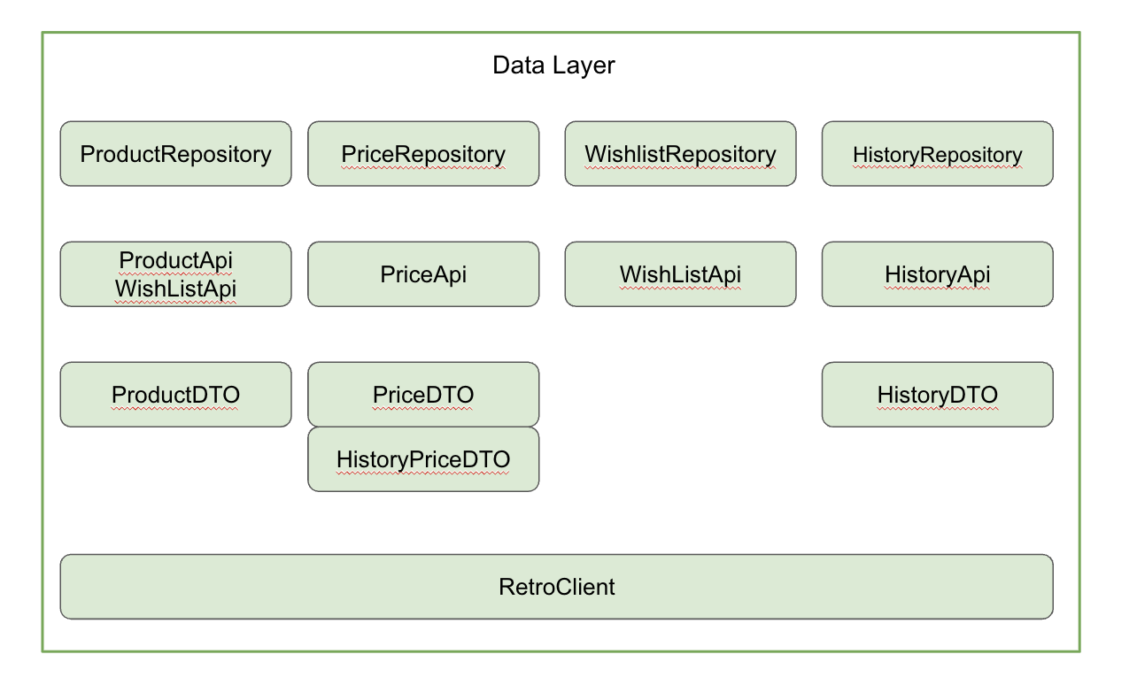
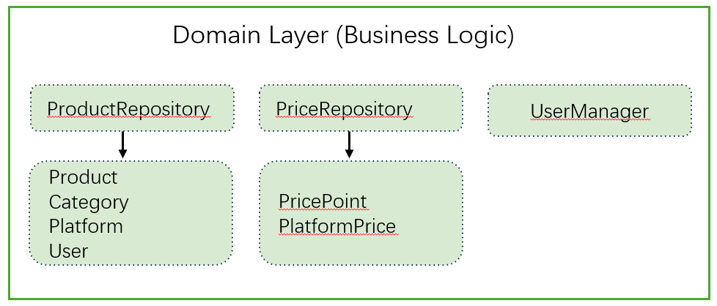
MVVM Architecture Diagram

Slide 5
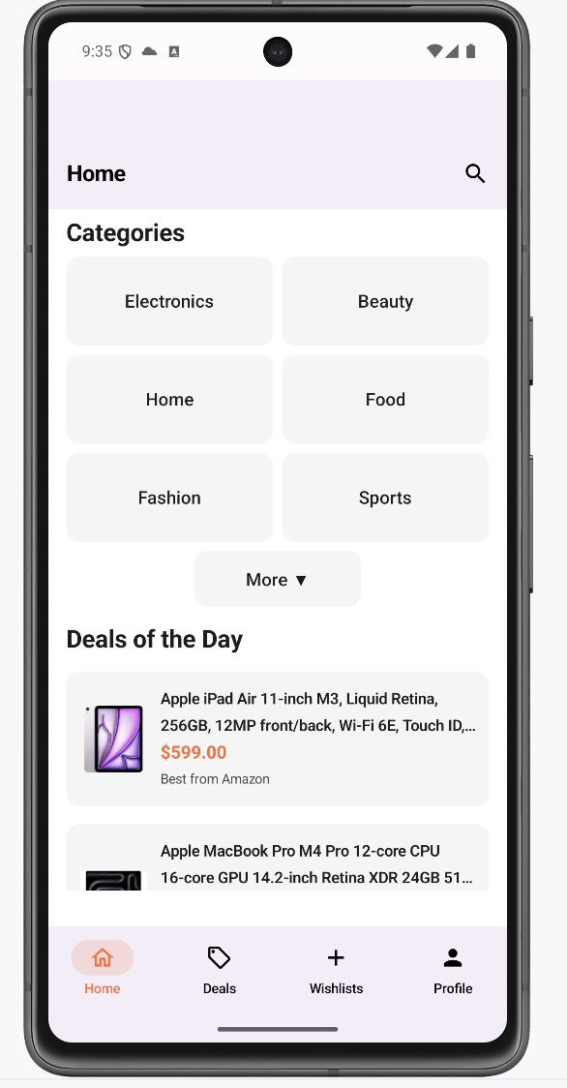
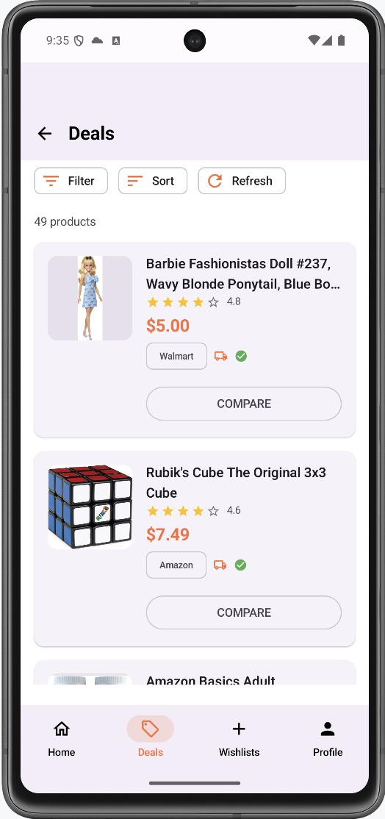
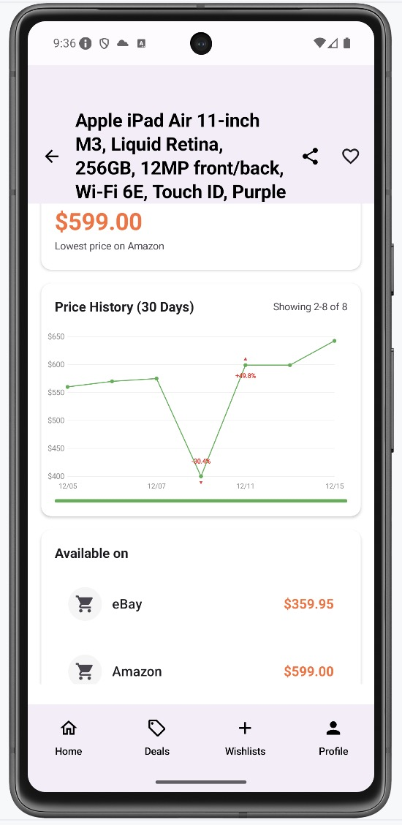
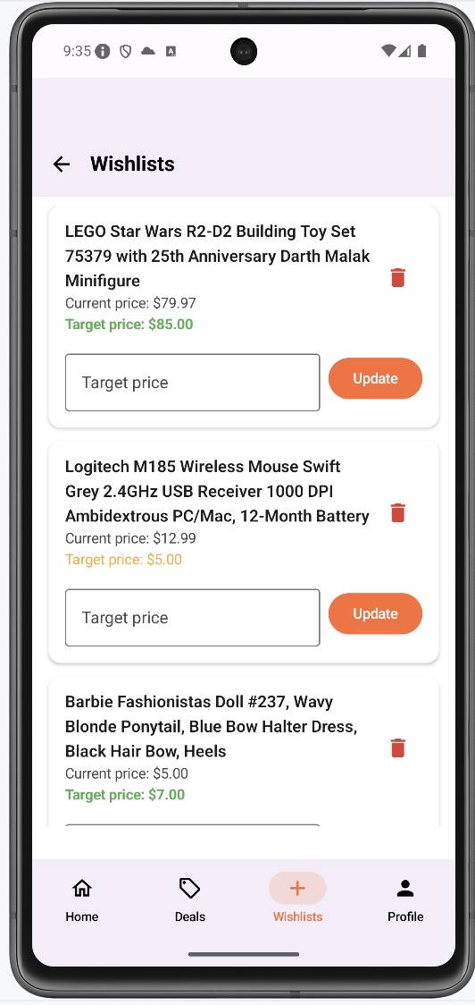
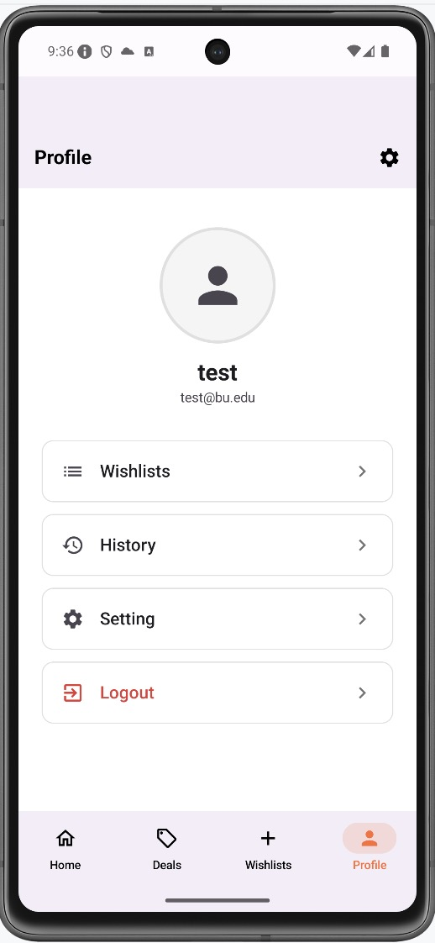
Navigate flow
Price chart
Go to search
View one product
HomeScreen
DealScreen
ProductScreen
Back to home
Back to Deals
Platform link
category
sort
recommendation
View list
filter
Setting
View List
WishlistScreen
ProfileScreen
History
View list
Edit
Log in
Sign up

Slide 6
Challenges & Lessons Learned
1. Handling consistent search navigation when the same screen can be reached from multiple entry points. --Solved
2. Deep Link Testing Challenges (sharing implementation) --Solved
3. API Trade-off: Used RapidAPI for lower costs, despite occasional data instability. --Unsolved
What we’ve learned:
- Our communication skills improved.
- With every discussion, we gained a deeper understanding of the project and became a much more cohesive team.
- Agile methodology throughout development.

Slide 7
AI Usage
- ChatGPT
1. Analyze the project, summarize technical highlights and core features, thereby help us write reports and make presentation.
2. Use OpenAI's API to perform natural language processing (NLP) for our projects: extract short titles from Amazon's titles; and use these short titles to query other platform APIs and determine which returned product titles best matched the original item.
- Claude
1. To enhance efficiency, we employed Claude to rapidly scaffold the project framework, while manually implementing detailed code logic ourselves, including all the feature and structure designing.
2. Quickly identify overlooked issues during debugging.

Slide 8
Future Work / Stretch Goals
- Stretch Goals
√product sharing
√personalized recommendations based on users’ browsing history
- Future Work
1. Enhance search and recommendations using vector-based search.
2. Improve recommendation quality by weighting different user behaviors.
3. Populate the database with thousands of items.

Slide 9
Thanks for Listening

